Slide 1

SPEEDOMETER
MUHAMMAD HASSAN KHALID (21L-5692)
MUHAMMAD HAMZA (21L-5636)

Slide 2
CIRCUIT Requirements
7-Segment Display
Register
Adder

Slide 3
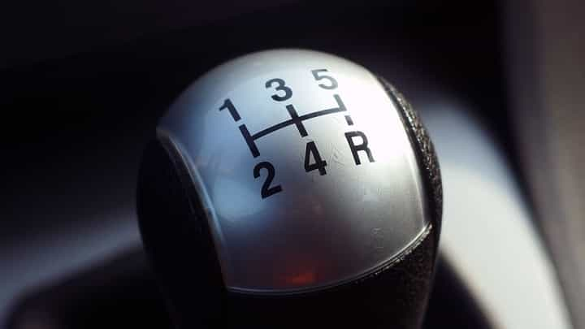
WHATS HAPPENING?
There are 5 gears and 1 reverse
Gear 1 increases speed by 1 M/PH
Gear 2 increases speed by 2 M/PH
Gear 3 increases speed by 3 M/PH
Gear 4 increases speed by 4 M/PH
Gear 5 increases speed by 5 M/PH
Reverse decreases speed by 1 M/PH

Slide 4
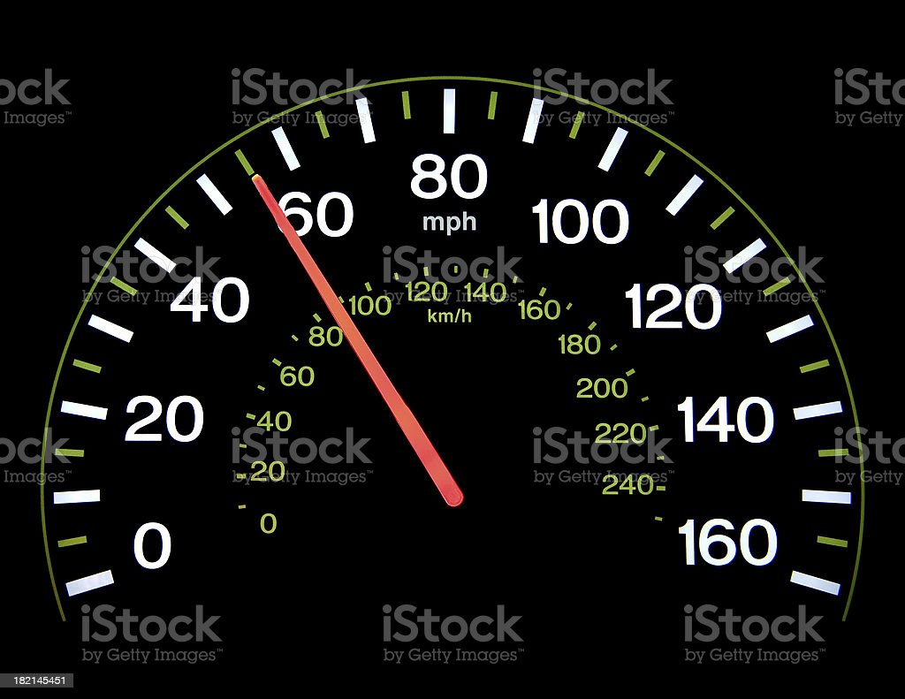
WHATS HAPPENING?
User enters a speed
The speed is retained by the register
The user then turns on a gear
The speed is again retained by a register
This register acts as a type of cruise control
The final output is displayed on the seven segment display

Slide 5
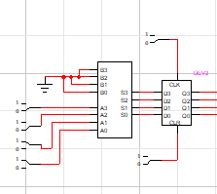
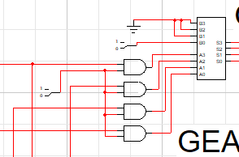
EXPLAINING THE CIRCUIT

Slide 6
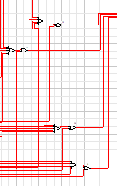

EXPLAINING THE CIRCUIT

Slide 7
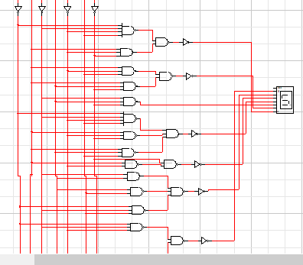

Slide 8
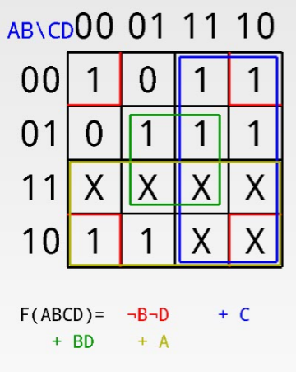
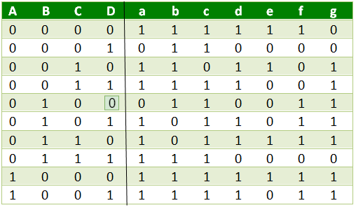
7-Segment display explanation

Slide 9

Thank You
ARE THERE ANY QUESTIONS?

